Slide 1
Cost optimizations for IaaS
Notes:
IMPORTANT NOTE:
Microsoft Ready will utilize Windows 10 and the new PowerPoint 2016, as well as PowerPoint 2013 on all event machines. Please build your slides utilizing the appropriate Template and utilize the version of PowerPoint that works best.
Windows 10 devices now connect remotely through VPN using the PIN with Passport for Work. Speakers needing to use VPN in a demo, will need to have registered for Phone Authentication at https://phoneregistration.microsoft.com. Additional details are also available here: https://microsoft.sharepoint.com/sites/itweb/securelogon/Pages/FAQ.aspx

Slide 2
Optimization is the path to success
Optimization is not a one-time effort
Cloud is a constantly changing place
New projects, new applications, changing loads
Resource optimization
Correct families & sizes
Correct resource/service types
Cost optimization
When to buy more/less Reserved Instances

Slide 3
Implementing optimization methods
Resize savings
$970
D14 v2 SKU, $1,400/mo
+
Resizing
=
D12 v2 SKU, $430/mo
+
Snoozing
Snooze savings
$162
=
D12 v2 SKU, $268/mo
Notes:
Rick
Presentation Notes:
Slide Objective:
Show real implementation of optimization methods used by Microsoft IT to save costs.
Speaker Notes:
Here is an example of an Azure IaaS server from our environment. It started as a D14 size SKU, this workload maxes out at around 25 percent CPU utilization as you can see. This utilization graph is using the P95 calculation to normalize the graph, this is the industry standard for measuring performance. This is not actually a “bad” example, CPU utilization can be 4 percent to 5 percent in an enterprise environment.
Using the P95 calculation, our algorithm and tools recommend that this workload be hosted on a D12 SKU, with a significantly lower monthly cost. Implementing this recommendation with the automation we’ve developed would yield $970 savings per month.
When we look at utilization during a typical workday, we see that the server isn’t in use from 9:00 PM until approximately 6:00 AM each day. If we implement a snooze schedule through automation, we can save an additional 40 percent in monthly costs without any impacts to the application this server supports.
As you can see, the only area that is shaded white is when the server is actually in use. We’ve gone from a server that cost $1400 per month to $268 dollars per month with no impact to the application.

Slide 4
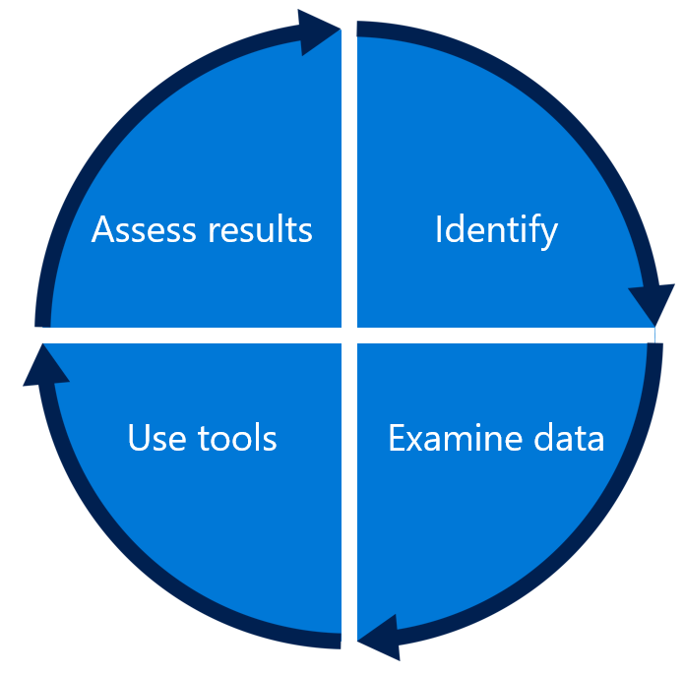
Lifecycle of optimization
Review the effects
Engineers identifying waste
Validate that the automated recommendations make sense
Implement savings changes
Notes:
Rick
Presentation Notes:
Slide Objective:
Share the process used to continuously improve resource efficiency.
Speaker Notes:
We’ve created a typical process workflow that drives optimization and education for application owners and engineers. There are four steps that define this process:
Identify. Engineers look at recommendations for virtual machine resources in their portfolio.
Examine data. They review and validate that the recommendations are correct and that the application can support the suggested actions. For example, is the code resilient enough to turn the server off at night? Is this something I can downsize realistically? This is an important part of the process that helps build trust in the recommendations.
Use tools. Implement recommendations with the snooze automation or resize automation tools.
Assess results. The engineer returns to view their resources and can see costs drop in real time.
The action of going through this process provides clarity on costs. More importantly, it drives better decisions when provisioning new resources, thereby leading to less waste from the start.

Slide 5
Microsoft IT CPU average
For IT-managed IaaS servers, last year we were able to…
Optimization tooling launched
Scope of ~6,000 servers
Industry average
Notes:
Speaker Notes:
When we originally released our Azure optimization tooling, which included Screamtest, Snooze, Megasnooze, Snooze Scheduler, and IaaS Resizer last year, we were near the industry standard at 6 percent CPU utilization. We expect that most of the rest of the company is still at this level. We did announcements and education campaigns to get these tools into the hands of the engineering community. As you can see in the graph, in four months, we were able to take our footprint of approximately 6,000 IaaS virtual machines and more than double their CPU efficiency, up to nearly 14 percent. So we know what we are capable of! Microsoft IT has a great story here, and it is thanks to the hard work of the engineering teams taking the time to right size, snooze, and delete unused servers.

Slide 6
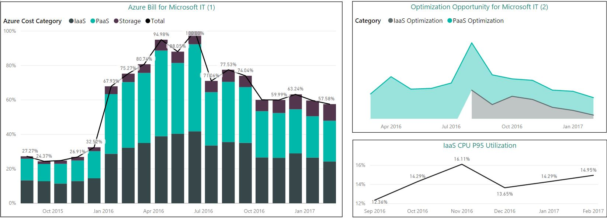
How have we done so far?
As we introduce new opportunities to save, our spend drops accordingly
Notes:
Rick
Speaker Notes:
Please stand up if you have used the ARO dashboard, or any of the optimization tools—VM Right Size, Snooze, Snooze Scheduler, and so on.
You see the drop over the last four months in our IT all up Azure spending? This is because of everyone standing, and our engineering community worldwide, optimizing. We are down double digits from last month, 11 percent. Give a round of applause—we’re watching culture change before our eyes right now. Efficient computing is showing in our costs, and in our CPU percentages. We can see on the right, our optimization opportunities are dropping very quickly after they’re introduced. We have more work to do here, but we’re seeing the results.

Slide 7
How does cost optimization work
User Experience
RBAC
Account Mgmt
Customization
Dashboards
Reports
Notifications
Analytics and Monitoring
Tag Enrichment
Budgets
Forecasting
Resource Optimization
Cost Optimization
Cost Allocation
Aggregation and Normalization
Data Collection
Data Sources
Data Types
Azure APIs
Other Cloud APIs
Billing data
Usage data
Utilization data
Resource metadata (e.g. tags)
Pricing data (rate-cards)

Slide 8
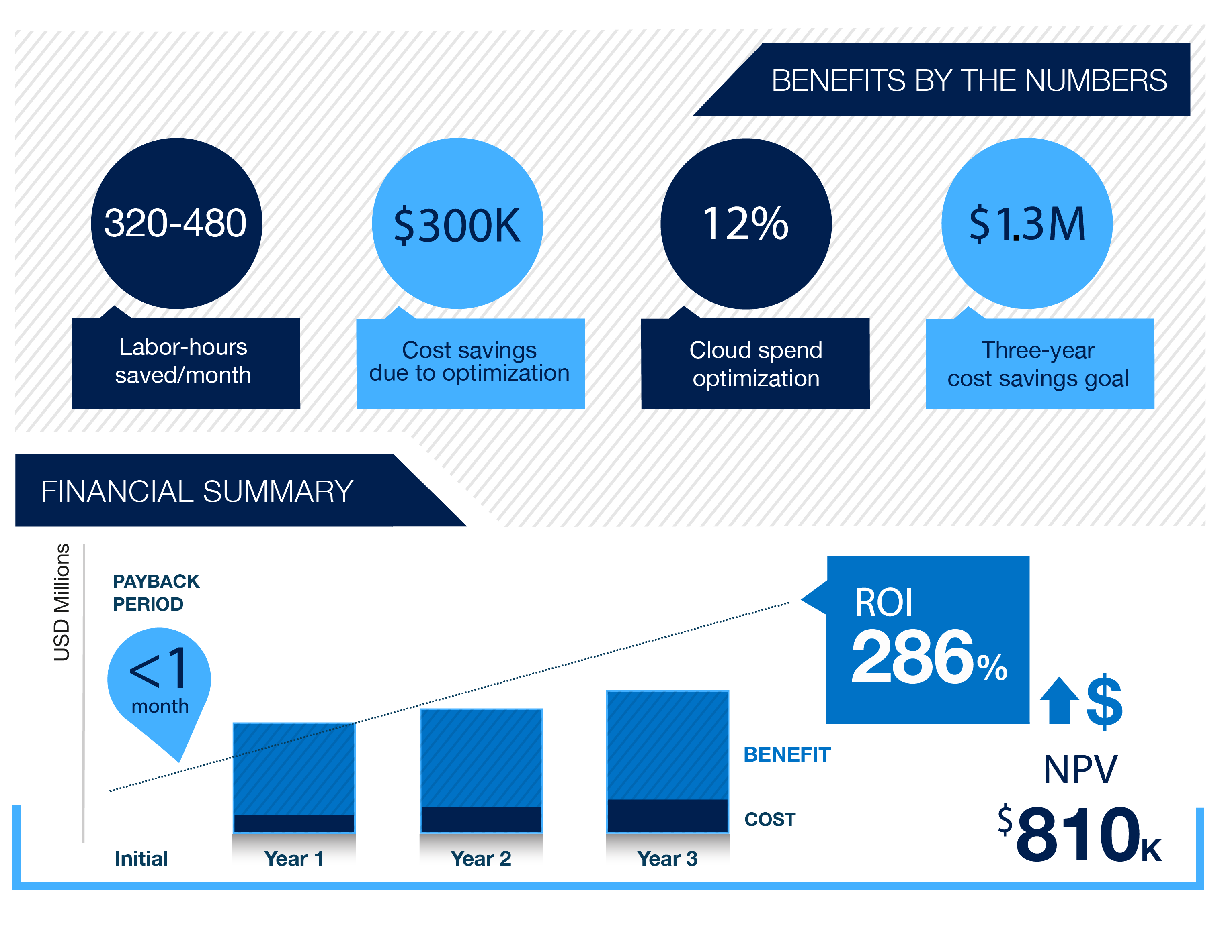

Azure Cost Management by Cloudyn delivers real customer impact
“$300,000 was saved by looking at different areas, reserving instances, and sizing properly. We were able to maximize the budget and plan for the future.” Cloud Architect Large U.S. software company
Forrester Total Economic Impact study

Slide 9
The road ahead
Sept 2017
Q4 2017
H1 2018
Access from Azure Portals
Managing Azure spend for FREE
Support for Azure EA, CSP
Support for Azure Direct
Support for AWS and Google Cloud Platform
Azure virtual machine reserved instances recommendations
Cost Management Free tier
Azure billable
Integration with other Azure services
Azure Advisor
Automation
Policy management
Our goal:
To be the best cloud cost management solution supporting a multi-cloud environment
Our goal:
To be the best cloud cost management solution supporting a multi-cloud environment

Slide 10
Free to manage your Azure spend
Capabilities | Managing Azure spend | Managing AWS and Google Cloud Platform spend
Reporting | Cost and usage reports | Cost and usage reports
Data enrichment | Categorize costs with resource tags Categorize costs with custom meta-tags¹ | Categorize costs with resource tags Categorize costs with custom meta-tags
Budgets | Create and manage cost and usage budgets Import external budgets¹ | Create and manage cost and usage budgets Import external budgets
Alerts and notifications | Create alerts on cost and usage budgets | Create alerts on cost and usage budgets
Recommendations | Eliminate idle Azure resources Right-size Azure resources Customize recommendation thresholds¹ | Eliminate idle cloud resources Right-size cloud resources Customize recommendation thresholds Optimize AWS EC2 Reserved Instances
Chargeback | Cost markup and reallocation¹ Custom charges¹ | Cost markup and reallocation Custom charges
Price | No charge | 1% of managed cloud spend
Use Azure Cost Management for free to manage your Azure spend
1. The highlighted premium capabilities for managing Azure spend will become paid features after June 2018.

Slide 11
Getting Started with Azure Cost Management
Easiest place to start is Azure Portal
Cost Management + Billing > Cost Management
Onboarding experience optimized for Azure customers and partners
To successfully get started you will need
CSP partners
Application ID, Commerce ID, and Application Secret Key from Partner Center portal
Direct customers
Live ID with User Access Admin or higher RBAC Role

Slide 12
Reserved Instances

Slide 13
There are many ways to save with Azure
Price Match Commitment
Innovative Products and Services
Cost and Governance
Compelling
Offers
Take price out of the equation on commodity services
Low priority VMs
B Series VMs
Archival Storage
Azure Cost Management
Azure Advisor
Azure Hybrid Benefit
License Mobility
Visual Studio Subscriptions
Azure Free Account

Slide 14
Introducing Azure Reserved VM Instances
Reserve virtual machines in advance
Select 1- or 3-year terms with significant benefits
Significant cost savings up to 82%* over pay-as-you-go models
Budget predictability and prioritized compute capacity
Flexibility to modify reservations and simplicity of purchase
*When combined with Azure Hybrid Benefit

Slide 15
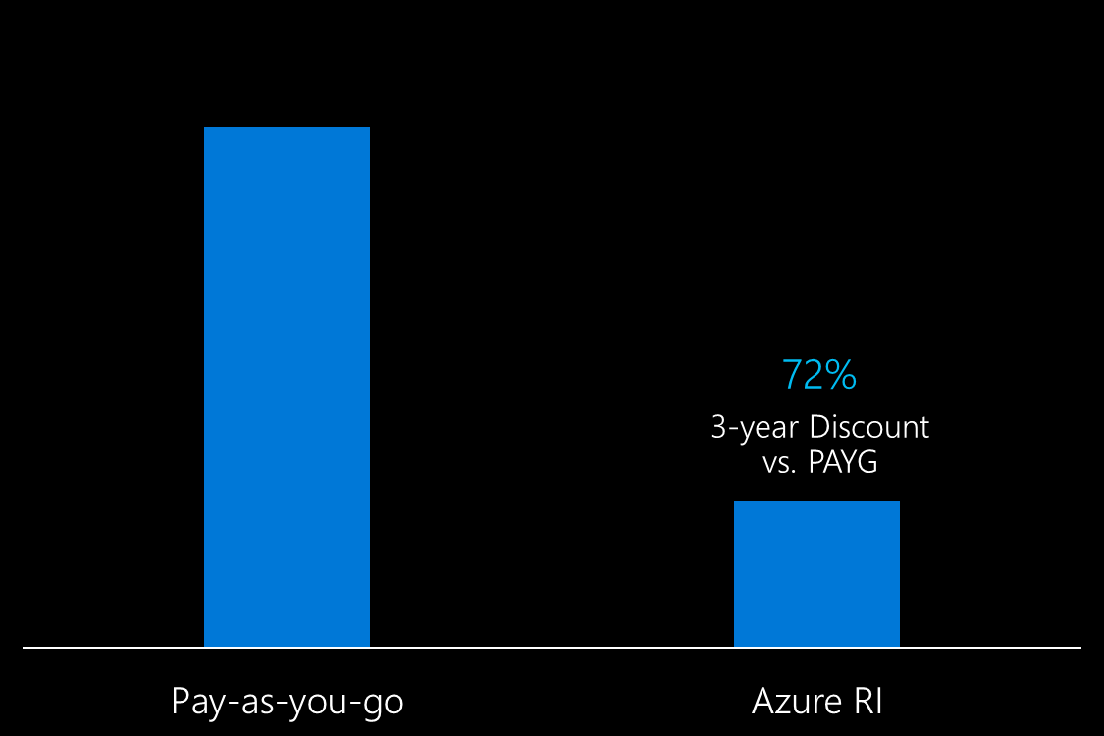
More cloud, less cost
Save up to 72% over pay-as-you-go pricing
3-year discount vs. pay-as-you-go
*Based on M series three-year RI

Slide 16
Typical savings with RI
Save 46%
Save 42%
Dv2 Series
Ev3 Series
Save 65%
Save 62%
1-year term
3-year term
1-year term
3-year term
Save 37%-38%
Save 42%
Save 60%-61%
Save 72%
F Series
M Series
1-year term
3-year term
1-year term
3-year term
Base VM pay-as-you-go price
Azure RI price

Slide 17
Azure Hybrid Benefit for Windows Server
Pay for just base compute costs by using your existing Windows Server licenses with Software Assurance
Apply licenses to Azure for use with Azure Reserved VM Instances
Maximize value from current investments
Available for both pay-as-you-go and Azure Reserved VM Instances

Slide 18
Most cost-effective cloud for Windows Server
Save 40% with Azure Hybrid Benefit for Windows Server
Save up to 82%* with the Azure Hybrid Benefit combined with RI
40% discount vs. pay-as-you-go
82% 3-year discount vs. pay-as-you-go
Pay-as-you-go
Azure Hybrid Benefit
RI + Azure Hybrid Benefit
*Based on Dv2 three-year RI with Azure Hybrid Benefit

Slide 19
Typical savings with RI
Save 46%
Save 42%
Dv2 Series
Ev3 Series
Save 65%
Save 62%
1-year term
3-year term
1-year term
3-year term
Save 37%-38%
Save 42%
Save 60%-61%
Save 72%
F Series
M Series
1-year term
3-year term
1-year term
3-year term
Base VM pay-as-you-go price
Azure RI price

Slide 20
Typical savings with RI + Azure Hybrid Benefit
Dv2 Series
Ev3 Series
Save 67%-68%
Save 65%
Save 74%-82%
Save 73%-77%
1-year term
3-year term
1-year term
3-year term
Save 58%
Save 56%-66%
Save 68%-78%
Save 80%
F Series
M Series
1-year term
3-year term
1-year term
3-year term
Base VM pay-as-you-go price
Azure RI + Azure Hybrid Benefit price

Slide 21
Improved budgeting and prioritized capacity
Improve budgeting and forecasting with a single up-front payment for 1- or 3-year terms
Plan, implement, and execute against desired workloads with prioritized capacity
Assign Azure Reserved VM Instances to tenant or subscription and change after purchase

Slide 22
Flexible reservation assignment
Assign RI benefit at
tenant level
OR
Assign RI benefit at
subscription level
Easily change assignment post purchase
CSP Customer Tenant
Subscription A
Subscription B
Subscription C
HR Department
IT Department
Finance Department

Slide 23
How Reserved VM Instances work
Ongoing Charges
VM Usage
WS Approach
RI Inventory
E2v3 US West WS VM
Azure Hybrid Benefit
E2v3 US West VM
Base VM hourly rate
$0
E2v3 US West WS VM
Hourly
E2v3 US West VM
WS per-core charge
WS VM hourly rate
E2v3 US West VM
Non-Windows VM
E2v3 US West VM
Base VM hourly rate
$0
D4v3 US West VM
Non-Windows VM
Base VM hourly rate
Base VM hourly rate

Slide 24
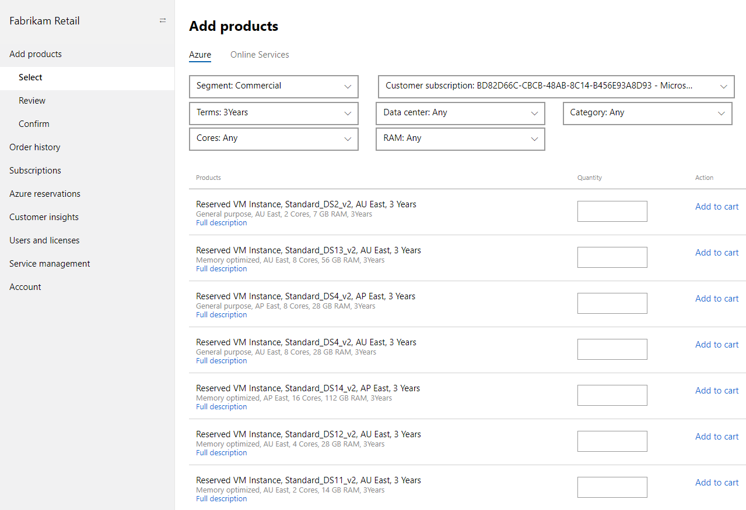
Easy purchase experience
Select:
Region
VM Size and Quantity
Term
Integrated into Partner Center portal

Slide 25
Exchange at any time
EXCHANGE
Exchange Azure RIs as your project needs change
Receive a prorated refund based on unused amount which applies fully to new purchase price

Slide 26

Cancel at any time
CANCEL
Cancel at any time if you find you no longer need the compute capacity you purchased …
Receive a prorated refund based on unused amount minus early termination fee

Slide 27
Azure RI differentiation
Feature | AWS | Azure
Most cost effective* for Windows Server
Simple purchase experience | Complex purchase experience
Assign reservation to an enrollment or subscription | Limited to billing account level
Exchange reservations for another in a different region or series | Convertible RIs available at a higher cost, three-year only, region-specific and have to be purchased up front
Cancel reservations for a pro-rated refund at any time | Sell reservations in a secondary marketplace
*On eligible VMs that support RI with Azure Hybrid Benefit

Slide 28

Why Azure RIs?
Enjoy the most cost effective* Windows Server workloads among all public cloud providers
Exchange or cancel your Azure RIs at any time
Simplify selections—reduce complexity and make purchase decisions with higher confidence and lower risk
Get the compute resources you need—when and where you need it
*On eligible VMs that support RI with Azure Hybrid Benefit

Slide 29
Total Economic Impact™ of Azure IaaS + PaaS
Microsoft Azure helps you save money with IaaS and PaaS:
Microsoft Azure IaaS | Microsoft Azure PaaS
ROI: 435% | ROI: 466%
NPV: $22.4M | NPV: $55.9M
IaaS
PaaS
Networking
Storage
Servers
On-premise/hosted/ outsourced infrastructure and compute to IaaS
Application development and deployment on PaaS
Visualization
O/S
Reduction in data center footprint and costs
Improvement in IT application management time
73%
80%
Middleware
Runtime
Reduction in IT outsourcing costs
Improvement in time per customer solution deployment
83%
50%
Data
Applications
Higher cloud maturity
Up to 63% increase in annual customer web sales
15% Improvement in project or transaction revenue
Managed by vendor
Managed by user
Source: The Total Economic Impact of Microsoft Azure Infrastructure As A Service (IaaS), June 2017. Values of costs and benefits are representative of a composite organization aggregated based on interviews with six Microsoft Azure IaaS Customers. The full study can be found at http://www.microsoft.com/azure.

Slide 30
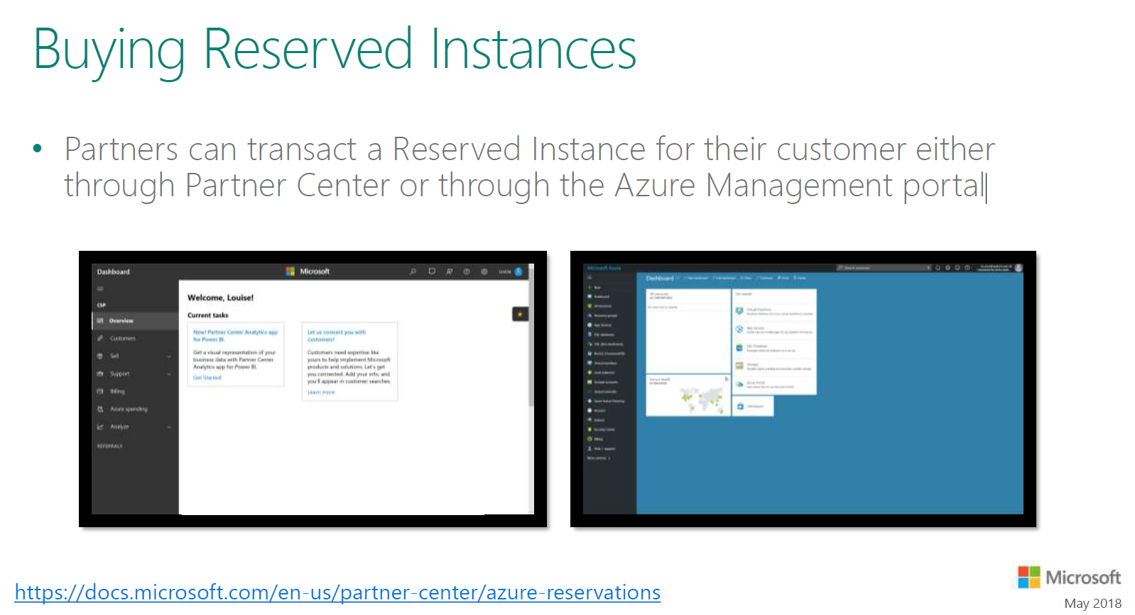

Slide 31
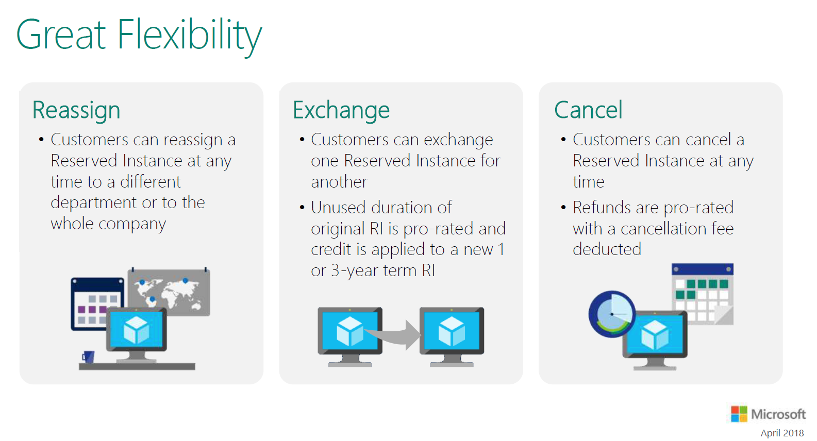

Slide 32
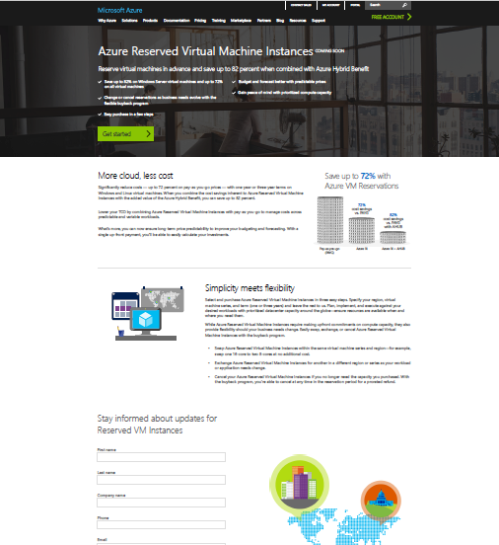
Learn More
Go to the Azure RI web page and sign-up for updates
Active your Azure Hybrid Benefit
Choose Azure for your Windows Server workloads
Estimate your monthly bill with the pricing calculator

